Slide 1

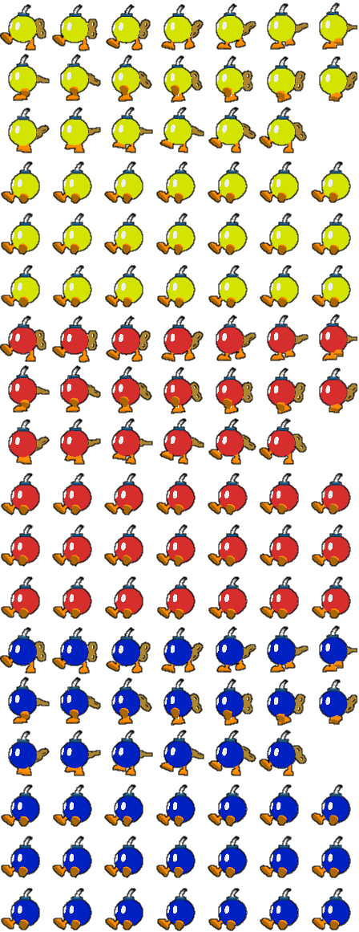
Екип:
Борислав Иванов
Ива Иванова
Мирослав Сергиев

Slide 2
Съдържание
Правила и инструкции за играта
Дизайн
Използвани структури от данни и особености в кода
Структура на кода
Класовете и тяхното проявление в играта
Нашия екип
Заключение

Slide 3
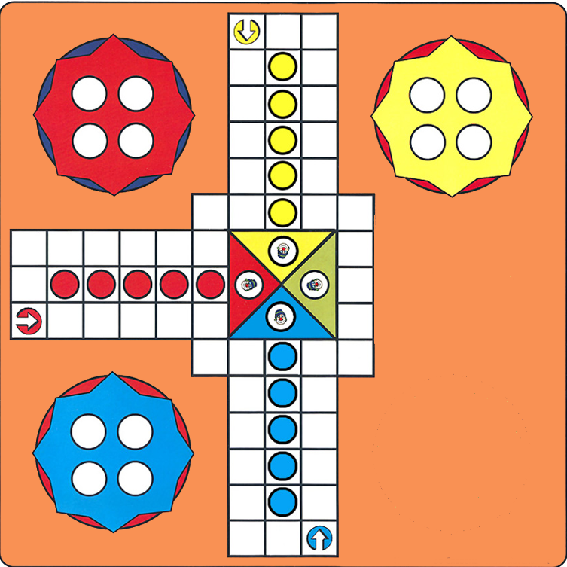
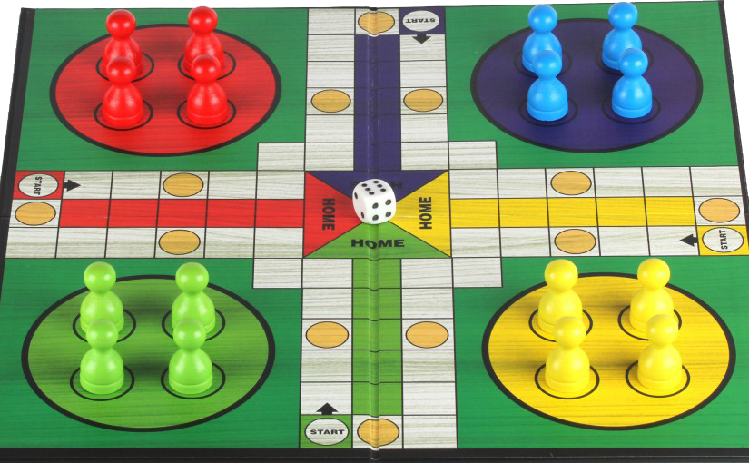
Не се сърди човече

Slide 4
Демонстрация

Slide 5
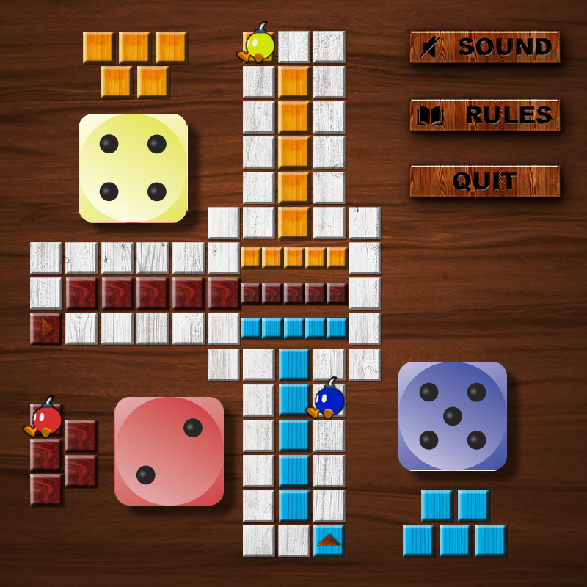


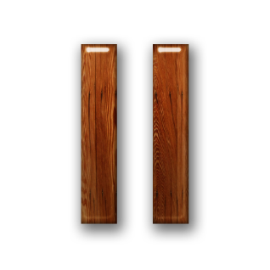
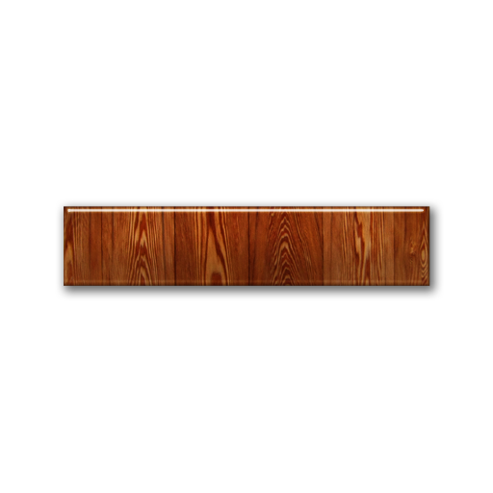
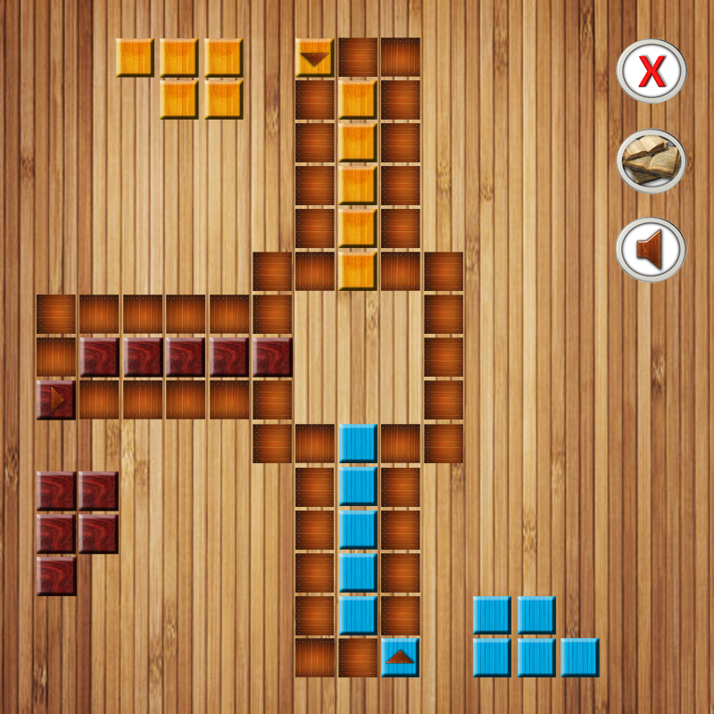
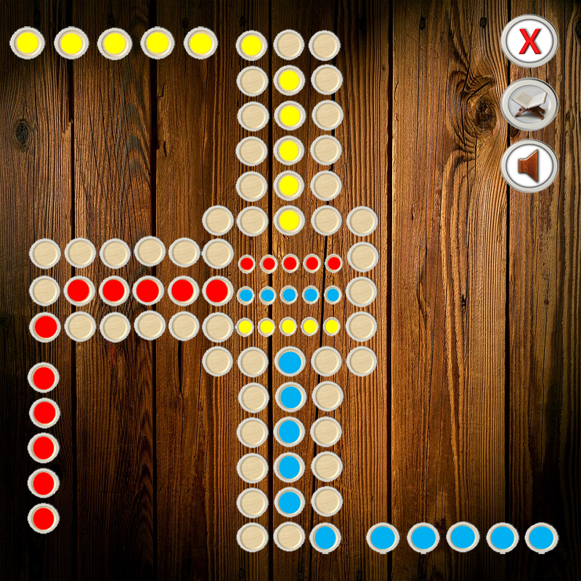

Дизайн
&

Slide 6


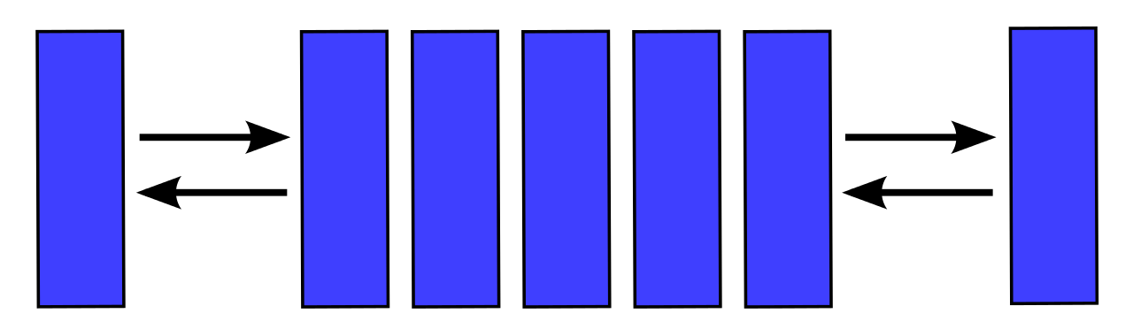
Използвани структури и особености в кода
/ector
Deque
Stringstream
Enum
Pugi
SDL
SDL_Mixer
SDL_Image
SDL_Ttf
//SDL_Renderer
Побитови операции
4.

Slide 7
Структура на кода
TitleScreen
Texture
Static
Recovery
Dice
Controls
Sound
Sprite
Game
RuleScreen
Pawn
Button
Constants
Shared
WinScreen
Player

Slide 8
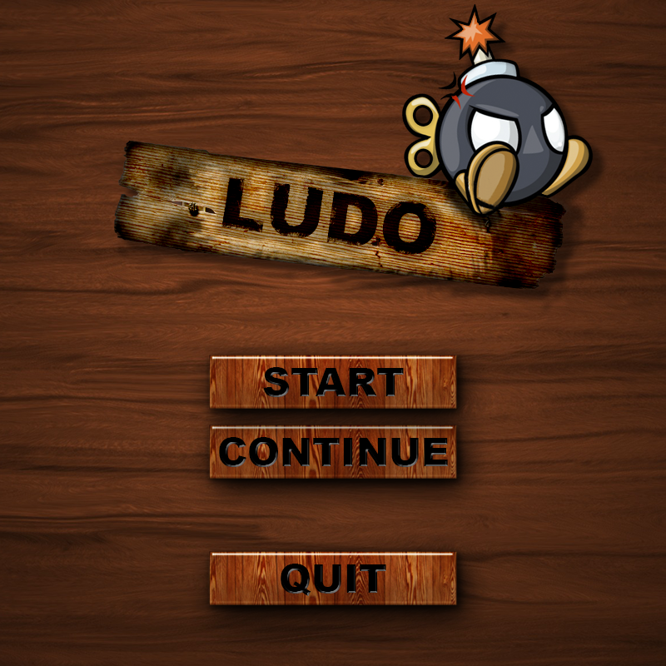
Class: TitleScreen
public:
WinScreen();
virtual ~WinScreen();
void init();
void render();
int eventHandler(SDL_Event& e);
void loadData(deque<Player*>);

Slide 9
Class: Game
public:
Game();
~Game();
void loop();
void setRenderer(SDL_Renderer* renderer);
void setEvent(SDL_Event& event);
void init();
void eventHandler();
void render(bool renderDice = 0);

Slide 10
Class: Rules

Slide 11
Helper classes: UI, Texture, Button, Sprite

Slide 12
Class: Player
public:
vector< Pawn* > m_vPawns;
Player(Colors color);
~Player();
void Print();
void Render(vector<pair<int, int>>);
void SetRenderer(SDL_Renderer*);
// setters & getters

Slide 13
Class: Pawn
public:
Pawn();
virtual ~Pawn();
void render(int x, int y);
void setRenderer
(SDL_Renderer* renderer);
// setters & getters

Slide 14
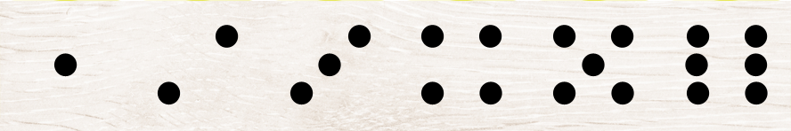
Dice
public:
Dice();
virtual ~Dice();
void render(Colors c);
void setRenderer(SDL_Renderer* renderer);
int roll();
bool Event(SDL_Event& e);
void init();

Slide 15


Class: Sound
public:
Sound();
static bool load();
static void pause();
static bool playing();
static void free();
static void play(SEFFECTS sound);
static void music(MUSIC music);
virtual ~Sound();

Slide 16
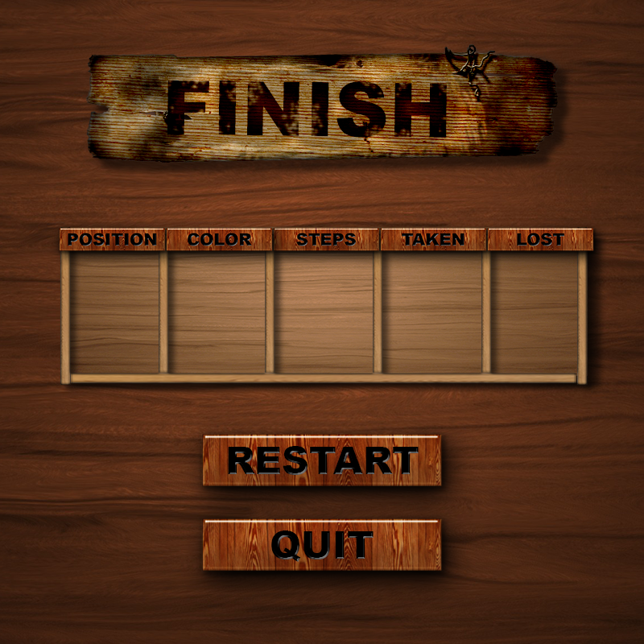
Class: WinScreen
public:
WinScreen();
virtual ~WinScreen();
void init();
virtual void render();
virtual int eventHandler(SDL_Event& e);
void loadData(deque<Player*>);

Slide 17
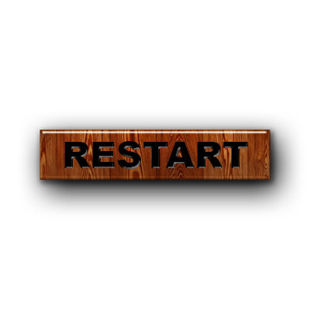

Class: Recovery
public:
Recovery();
virtual ~Recovery();
static deque< Player* > ReadFromXML();
static void WriteXML(deque <Player*>, bool rolled = 0);
static void Print(deque <Player*>);
static bool hasRolled;

Slide 18
Екипа

Slide 19
Заключение

Slide 20

Благодарим за вниманието!

